Slide 1

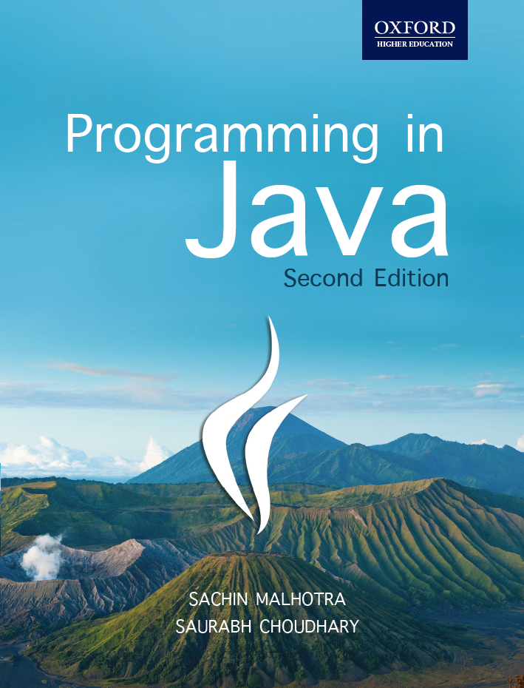
Programming in Java, 2e
Sachin Malhotra
Saurabh Choudhary

Slide 2
Chapter 7
Exception Assertion and Logging

Slide 3
Objective
understand the concepts and application of exception handling
understand all the keywords used for exception handling
create user-defined exceptions
know what assertions are and how to use them
know the basics of Logging

Slide 4
Exception
Exceptions in real life are rare
are usually used to denote something unusual that does not conform to the standard rules.
In programming, exceptions are events that arise due to the occurrence of unexpected behavior in certain statements, disrupting the normal execution of a program.

Slide 5
Causes of Exception
Exceptions can arise due to a number of situations. For example,
Trying to access the 11th element of an array when the array contains of only 10 element (ArrayIndexOutOfBoundsException)
Division by zero (ArithmeticException)
Accessing a file which is not present (FileNotFoundException)
Failure of I/O operations (IOException)
Illegal usage of null. (NullPointerException)

Slide 6
Exception Classes
Top class in exception hierarchy is Throwable
This class has two siblings: Error and Exception.
All the classes representing exceptional conditions are subclasses of the Exception class.

Slide 7
What happens when an execution occurs?
runtime environment identifies the type of Exception and throws the object of it.
If the method does not employ any exception handling mechanism
the exception is passed to the caller method, and so on.
If no exception handling mechanism is employed in any of the Call Stack methods
the runtime environment passes the exception object to the default exception handler available with itself.
The default handler prints the name of the exception along with an explanatory message followed by stack trace at the time the exception was thrown and the program is terminated.

Slide 8
Exception Example
class ExDemo {
public static void main(String args[]){
method1(); }
static void method1(){
System.out.println(“IN Method 1, Calling Method 2”);
method2();
System.out.println(“Returned from method 2”);
}
static void method2(){
System.out.println(“IN Method 2, Calling Method 3”);
method3();
System.out.println(“Returned from method 3”);
}
static void method3(){
System.out.println(“IN Method 3”);
int a=20,b=0;
int c=a/b;
System.out.println(“Method 3 exits”); }}

Slide 9
The output
IN Method 1, Calling Method 2
IN Method 2, Calling Method 3
IN Method 3
Exception in thread “main” java.lang.ArithmeticException: / by zero
at ExDemo.method3(ExDemo.java:23)
at ExDemo.method2(ExDemo.java:16)
at ExDemo.method1(ExDemo.java:10)
at ExDemo.main(ExDemo.java:5)

Slide 10
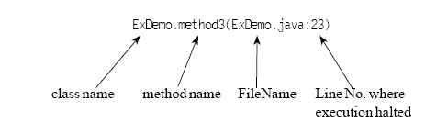
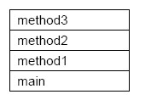
Stack Trace

Slide 11
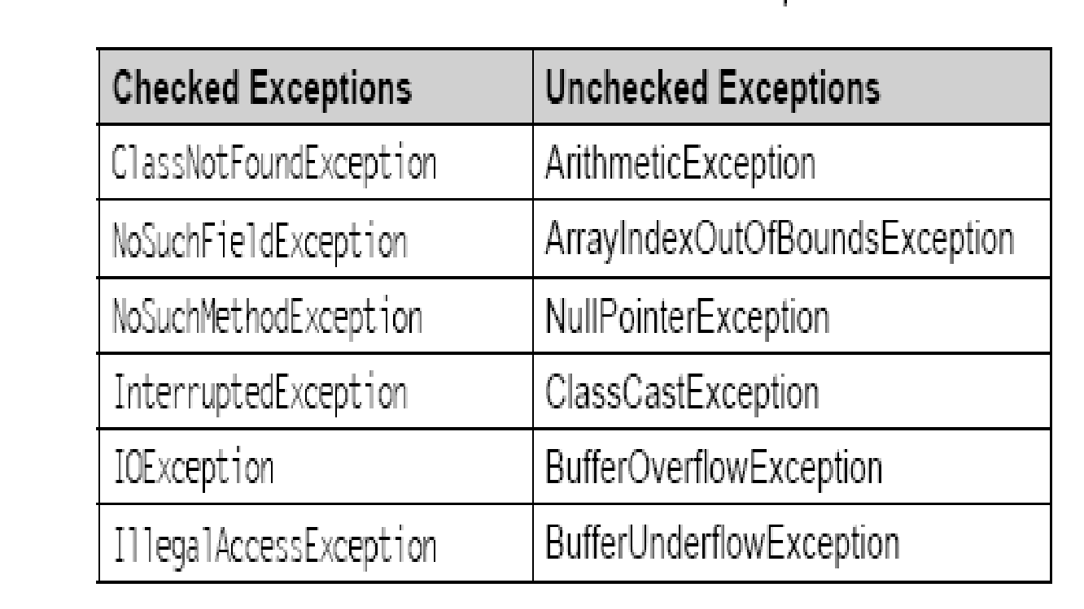
Types of Exceptions

Slide 12
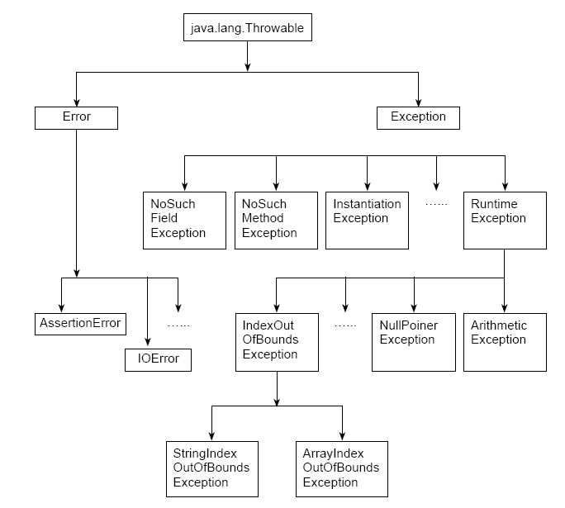
Exception Hierarchy

Slide 13
Exception Handling Techniques
try..catch
throw
throws
finally

Slide 14
try…catch
try/catch block can be placed within any method that you feel can throw exceptions.
All the statements to be tried for exceptions are put in a try block
catch block is used to catch any exception raised from the try block.
If exception occurs in any statement in the try block control immediately passes to the corresponding catch block.

Slide 15
Example
static void method2()
{
System.out.println(“IN Method 2, Calling Method 3”);
try{
method3();
}
catch(Exception e)
{
System.out.println(“Exception Handled”);
}
System.out.println(“Returned from method 3”);
}

Slide 16
Multiple catch clauses
static void method2()
{
System.out.println(“IN Method 2, Calling Method 3”);
try{
method3(); }
catch(ArithmeticException ae)
{
System.out.println (“Arithmetic Exception Handled: “ +ae);
}
catch(Exception e)
{
System.out.println(“Exception Handled”);
}
System.out.println(“Returned from method 3”);
}
Note: catch having super class types should be defined later than the catch clauses with subclass types. The order is important.

Slide 17
Nested try..catch
try{ …..//statements
try{ …..//statements
}
catch(ArithmeticException ae){ . . . .}
…// statements
try{…//statements}
catch(ArrayIndexOutOfBoundsException ie){}
}
catch(Exception e){…..}

Slide 18
throw keyword
used to explicitly throw an exception.
useful when we want to throw a user-defined exception.
The syntax for throw keyword is as follows:
throw new ThrowableInstance;
For example
throw new NullPointerException();

Slide 19
throws keyword
is added to the method signature to let the caller know about what exception the called method can throw.
responsibility of the caller to either handle the exception (using try…catch mechanism) or it can also pass the exception (by specifying throws clause in its method declaration).
If all the methods in a program pass the exception to their callers (including main( )), then ultimately the exception passes to the default exception handler.

Slide 20
throws syntax
A method can throw more than one exception; the exception list is specified as separated by commas.
The syntax for the throws keyword is shown below:
public void divide(int a, int b) throws ArithmeticException, IllegalArgumentException

Slide 21
Your turn
What is Exception?
What precaution to be taken while using multiple catch clauses?
Can statements be placed after throw clause?
What is the difference between throw and throws?

Slide 22
finally
finally block is executed in all circumstances
if the exception occurs or
it is normal return (using return keyword) from methods.
mandatory to execute statements like related to release of resources, etc. can be put in a finally block.
The syntax of the finally keyword is as follows:
try {……}
catch(Throwable e){……}
finally {……..}

Slide 23
finally example
class FinallyDemo{
public static void main(String args[])
{
method1();
System.out.println(“Result : “+method2 (24,0));
}
static void method1(){
try{
System.out.println(“IN Method 1”);
throw new NullPointerException(); }
catch(Exception e) {
System.out.println(“Exception Handled: “ + e); }
finally {
System.out.println(“In method 1 finally”);} }
static int method2(int a,int b){
try{
System.out.println(“IN Method 2”);
return a/b; }
finally {
System.out.println(“In method 2 finally”);} } }

Slide 24
The Output
When a=24 and b=4
IN Method 1
Exception Handled:java.lang.NullPointerException
In method 1 finally
IN Method 2
In method 2 finally
Result : 6
When a=24 and b=0
IN Method 1
Exception Handled: java.lang.NullPointerException
In method 1 finally
IN Method 2
In method 2 finally
Exception in thread “main” java.lang.ArithmeticException: / by zero
at FinallyDemo.method2(FinallyDemo.java:24)
at FinallyDemo.main(FinallyDemo.java:6)

Slide 25
try-with-resources Statement
Java 7 added a new enhancement i.e., automatic resource management with a try-with-resources statement.
The applications uses many resources during their lifetime by creating their objects,
e.g., creating a data base connection for accessing/updating databases,
or creating file objects for working with files,
or creating sockets for transmission/ receiving of data, etc.

Slide 26
try-with-resources Statement
A common mistake committed by programmers is that they often do not close/release the resources occupied by the programs, after their task is complete.
This leads to many orphaned instances, inefficient memory allocation, and garbage collection.
Hence the need for automatic resource management arises.

Slide 27
try-with-resources Statement
To address this problem AutoCloseable, a new interface has been created in the java.lang package.
The resources that want to be closed automatically after use must implement this interface.
This interface has just one method,
public void close() throws Exception

Slide 28
Syntax of try-with-resources Statement
For example
try (abc a=new abc(); pqr p=new pqr())
{ // statements within the block }
More than one AutoCloseable resources can be used in try-with-resources statement separated by semicolon.
abc and pqr objects should implement the AutoCloseable interface

Slide 29
Multi catch
Java 7 introduced the multi catch statement to catch multiple exceptions using a single catch try {
// statements
}
catch (Exception1 | Exception2 | Exception3 e)
{ // statements }
Exception1, Exception2, and Exception3 , belonging to different hierarchies are handled in a single catch block. For e.g.

Slide 30
Benefits of multi catch
results in more efficient byte code as you have just one catch block (instead of more as in the above case).
Moreover same treatment can be applied to exceptions of different hierarchies.
A way of applying different treatment while using multi catch syntax is by using instanceof operator

Slide 31
Example
catch(ArithmeticException | ArrayIndexOutOfBoundsException | NumberFormatException e)
{
if(e instanceof ArithmeticException)
System.out.println("Arithmetic Exception Handled: " +e);
else if(e instanceof NumberFormatException)
System.out.println("Exception Handled: " +e);
else
System.out.println(e); }

Slide 32
Improved Exception Handling in Java 7
A method can specify only those exceptions in the throws clause that have been specified in the catch clause while re-throwing exceptions from within catch block
But Java 7 onwards the throws can specify more refined exceptions to be rethrown.
Suppose there are two user defined exceptions Exception1 and Exception2 which can be rethrown from within the catch block of a method.

Slide 33
Improved Exception Handling
class DemoException {
void throwException(int a, int b) throws Exception1, Exception2 {
try {
if (a<b)
throw new Exception1();
else
throw new Exception2();
} catch (Exception e) {
throw e; }}
public static void main(String args[]) throws Exception1,Exception2 {
new DemoException().throwException(4,0); }}

Slide 34
Improved Exception Handling
Prior to Java 7 only the exceptions specified in the catch block can be mentioned as argument to the throws keyword.

Slide 35
User Defined Exception
class ExcepDemo extends Exception
{
ExcepDemo(String msg){
super(msg); }
public String toString()
{
return “Exception in thread \”main\” ExcepDemo Exception: “+getMessage();
} }

Slide 36
Exception Encapsulation
Also known as chaining
wrapping a caught exception in a different exception and throwing the wrapped exception.
If you pass all your exception, your top level method might have to deal with a lot of exceptions and declaring or handling exceptions in all the methods back is a tedious task.
Wrapping is also used to abstract the details of implementation. You might not want your working details (including the exception that are thrown) to be known to others.

Slide 37
Exception Encapsulation
try{
throw new InstantiationException();
} catch(InstantiationException t)
{ // wrapping InstantiationException in //ExcepDemo
throw new ExcepDemo(“Wrapped Instantiation Exception”,t);
}

Slide 38
Problems & Solution
It leads to long stack traces; one for each exception in the wrapping hierarchy.
Secondly, due to wrapping, it becomes difficult to figure out the problem that led to exceptions.
Solution: Exception Enrichment

Slide 39
Exception Enrichment
you do not wrap exceptions but add information to the already thrown exception and rethrow it, which leads to a single stack trace.

Slide 40
Example
class ExcepDemo extends Exception{
String message;
ExcepDemo(String msg) {
message=msg; }
public String toString() {
return “Exception in thread \”main\” ExcepDemo Exception: “+message; }
public void addInformation(String msg) {
message+=msg; }}
class ExceptionEnrichmentDemo{
static void testException() throws ExcepDemo{
try{
throw new ExcepDemo(“Testing User Defined Exception”);
}
catch(ExcepDemo e) {
e.addInformation(“\nexception was successfully enriched and re-thrown from catch”);
throw e; } }
public static void main(String args[]) {
try {
testException(); }
catch(ExcepDemo e){
System.out.println(e); }}}

Slide 41
The output
Exception in thread “main” ExcepDemo Exception: Testing User Defined Exception
exception was successfully enriched and re-thrown from catch

Slide 42
Assertions
to create reliable programs that are correct and robust.
Assertions are boolean expressions that are used to test/validate the code.
They are basically used during testing and development phases.
Assertions are used by the programmers to be doubly sure about a particular condition, which they feel to be true.
If you expect a number to be positive, negative, array/reference is not null, etc. then you can check these conditions by asserting them.

Slide 43
assert example
Assertions in Java are declared with the help of assert keyword as shown below:
assert expression1; // assert x > 0;
Or
assert expression1: expression2; // assert x < 0: “Value Ok”;
Assertions have to be enabled explicitly; they are disabled by default.
options of Java can be used to enable and disable assertions.
-ea enable assertions
-da disable assertions

Slide 44
Assertion example
class AssertDemo
{
static void check(int i)
{
assert i>0: “Value must be positive”;
System.out.println(“value fine “+i);
}
public static void main(String args[])
{
check(Integer.parseInt(args[0]));
}}

Slide 45
The output
When i = 1
C:\javabook\programs\chap 7>java -ea AssertDemo 1
value fine 1
When i = –1
C:\javabook\programs\chap 7>java -ea AssertDemo -1
Exception in thread “main” java.lang.AssertionError: Value must be positive
at AssertDemo.check(AssertDemo.java:5)
at AssertDemo.main(AssertDemo.java:10)
Without enabling Assertion
C:\javabook\programs\chap 7>java AssertDemo -1
value fine -1

Slide 46
LOGGING
added in the java.util.logging package
Logs are basically used to report messages regarding the functioning of the application to the programmer.
Logs are created with the help of a Logger class
These messages are passed to handler objects which pass these messages to console, log files, etc.
Loggings has nine levels in Java to indicate the severity of logged messages.
These levels are final and static fields of Level class (util.logging package).

Slide 47
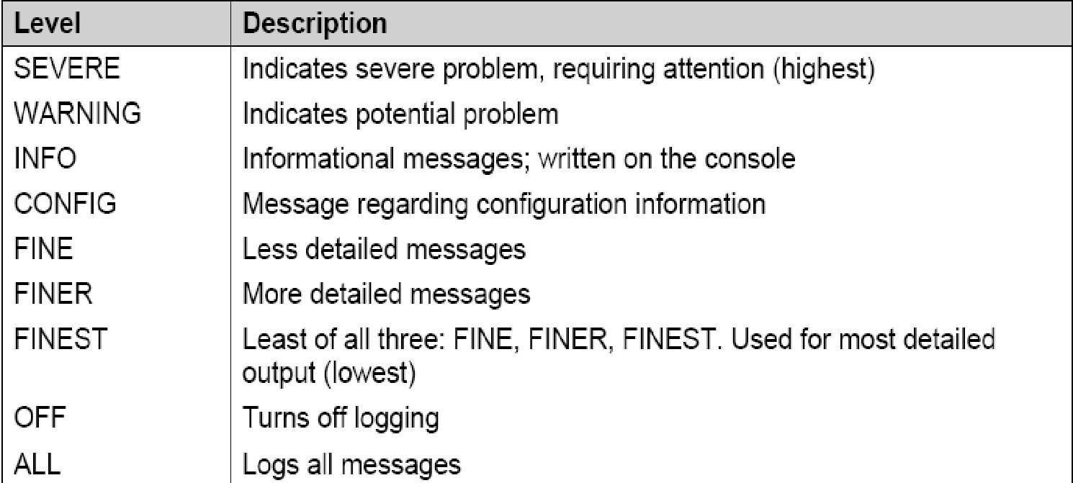
Levels of Logging

Slide 48
Methods of Logger class
The Logger class provides methods similar to the names of the levels for logging messages.
public void severe(String msg)
public void warning(String msg)
public void config(String msg)
public void info(String msg)
public void finest(String msg)
public void finer(String msg)
public void fine(String msg)
it also provides a method which sets the level as well as prints the message on the console.
public void log(Level l,String msg)

Slide 49
Example
import java.util.logging.*;
class LoggingDemo {
static Logger l = Logger.getLogger(“LoggingDemo”);
void demo() {
l.log(Level.SEVERE,”Shows Severe level of the Logger “);
}
public static void main(String[] args) {
LoggingDemo d = new LoggingDemo();
d.demo();
}}

Slide 50
The Output
C:\javabook\programs\chap 7>java LoggingDemo
22 Feb, 2009 11:18:49 AM LoggingDemo demo
SEVERE: Shows Severe level of the Logger

Slide 51
Summary
This chapter focused on how to handle unusual conditions/situations in Java.
Two types of exceptions have been defined: Checked and Unchecked.
five keyword in exception handling, namely try, catch, throw, throws, and finally have been discussed.
Apart from using the predefined exception, you can code your own exceptions according to your own requirements.
Improvements in Java 7 have been explained like automatic resources management, multi catch etc.

Slide 52
Summary (contd.)
Assertions (introduced in JDK 1.4) are helpful in assuring the programmer about a particular condition using assert keyword.
They help in increasing the reliability of a Java program.
Logging features (part of java.util.logging package introduced in JDK 1.4) help the user to debug his program and can exactly pinpoint the errors in his/her program.

